Slide 1
throws keyword in java?
momedaram

Slide 2
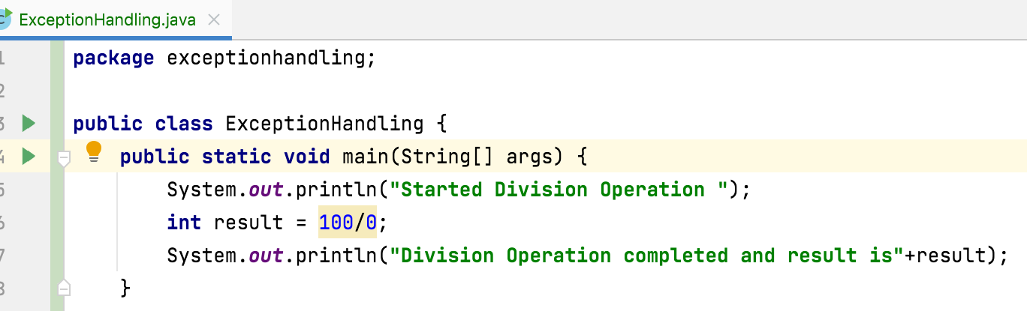
Exception is an abnormal condition which occurs during the execution of a program and disturbs the normal flow of a program.

Slide 3
Types of Exceptions:
Checked exceptions - which are checked during compilation itself
Ex. FileNotFoundException, IOException,
SQLException, ClassNotFoundException
Unchecked exceptions - which are not checked during compilation
Ex. NullPointerException, ArithmeticException,
ClassCastException, ArrayIndexOutOfBoundsException

Slide 4
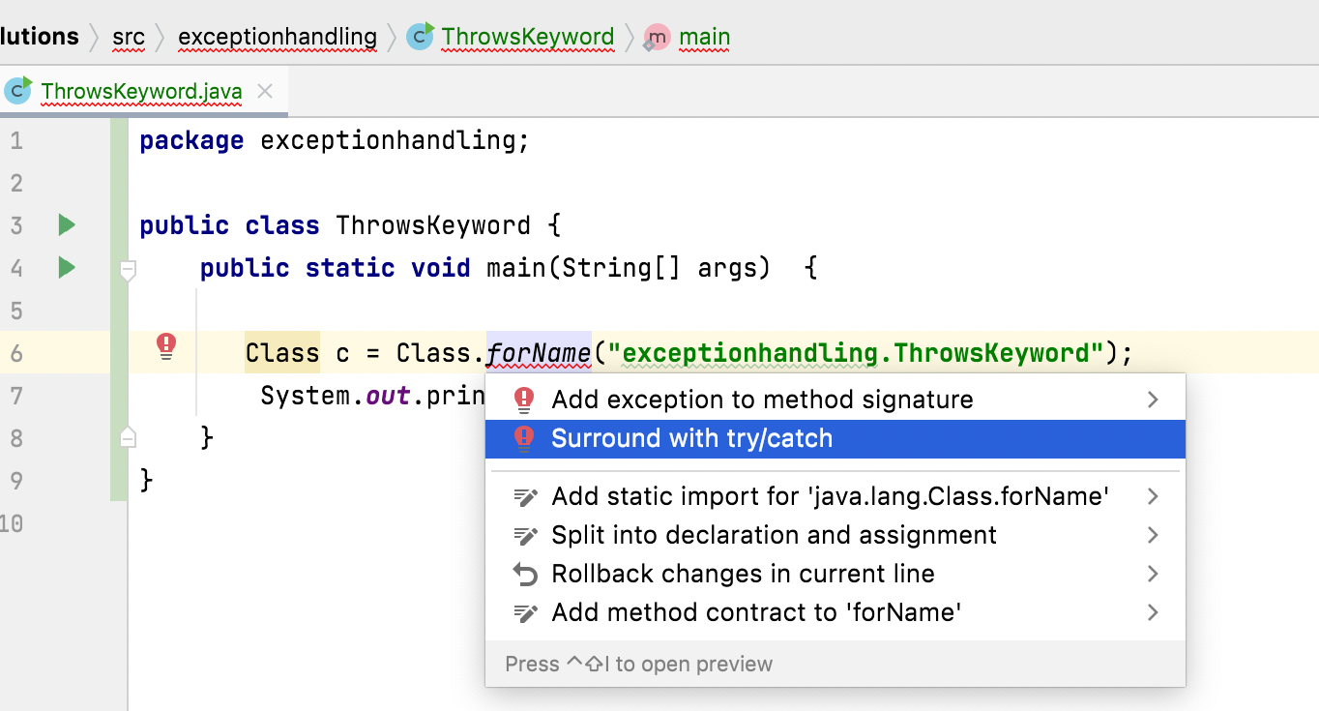
In our program if there is any chance of raising checked exception then compulsory, we should handle either by try catch or by throws keyword otherwise the code won't compile.

Slide 5
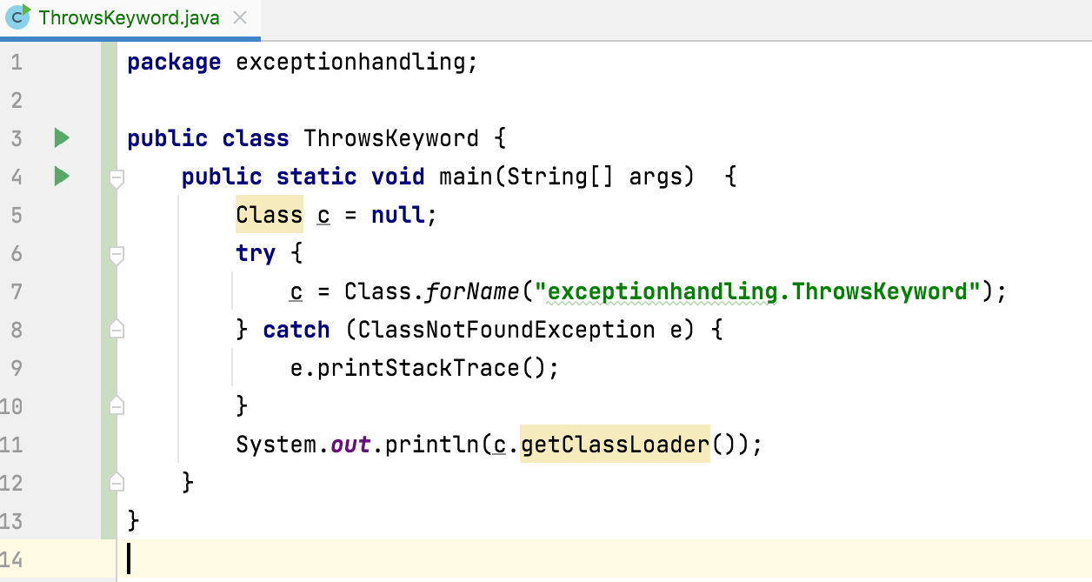
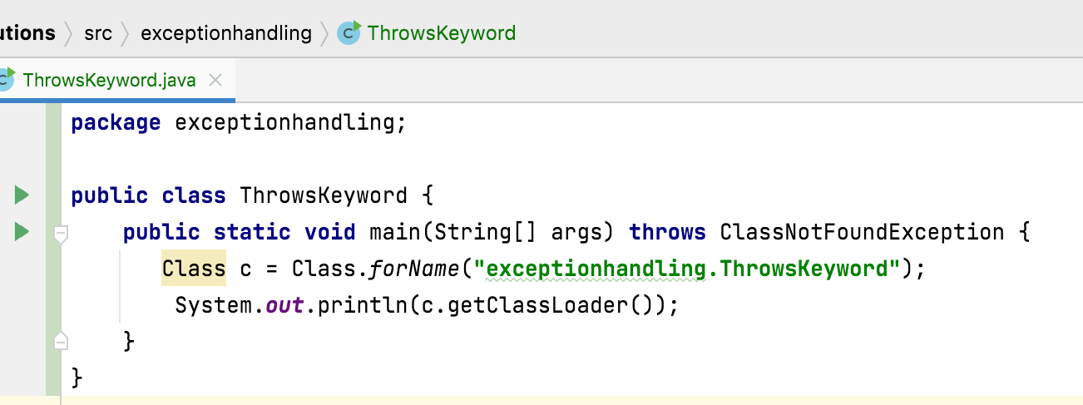

Slide 6
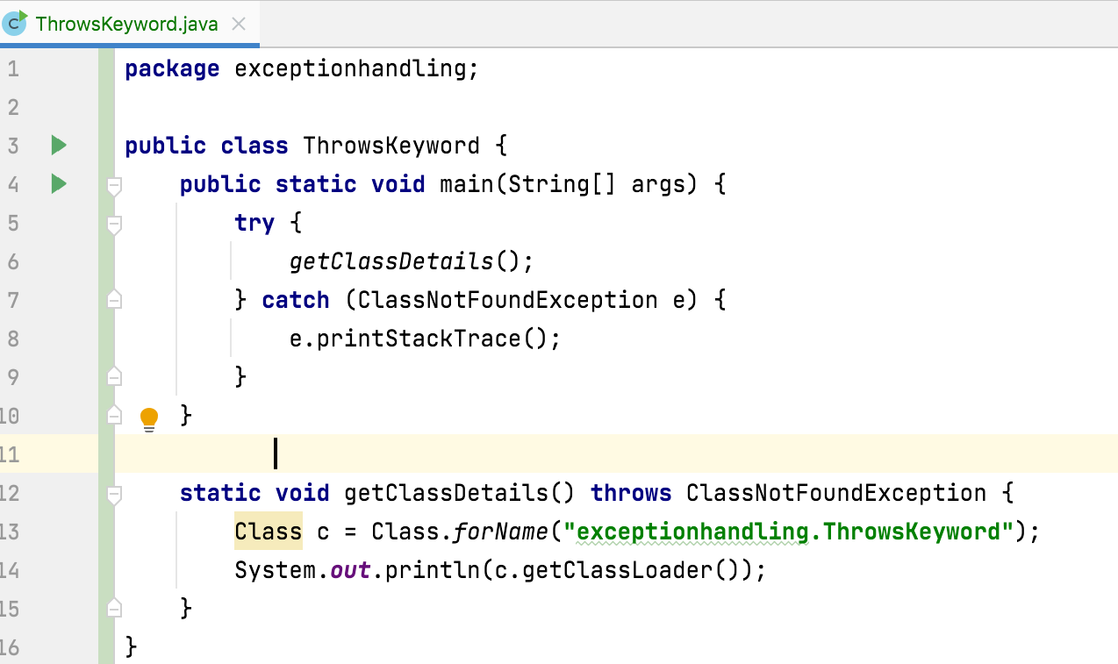
We can use throws keyword to delegate the responsibility of exception handling to the caller method. Then caller method is responsible to handle that exception.

Slide 7
Key Points:
The objective of throws keyword is to delegate the responsibility of exception handling to the caller method.
throws keyword required only checked exceptions.
throws keyword required only to convince complier. Usage of throws keyword doesn't prevent abnormal termination of the program.
It is recommended to use try-catch overthrows keyword.
we can use throws keyword only for Throwable types otherwise we will get compile time error saying incompatible types.
We can use throws keyword only for constructors and methods but not for classes.

Slide 8

Thank You !
momedaram

